Slide 1
Software Project Management

Slide 2
Why is SPM?
SPM- The main goal of software project management is to enable a group of developers to work effectively towards the successful completion of a project.
Who is responsible for SPM?
Small Projects
Large Projects

Slide 3
SOFTWARE PROJECT MANAGEMENT COMPLEXITIES
Invisibility
Changeability
-Frequent changes to the requirements and the invisibility of software are possibly the two major factors making software project management a complex task
Exactness of the solution
Complexity

Slide 4
RESPONSIBILITIES OF A SOFTWARE PROJECT MANAGER
Job Responsibilities for Managing Software Projects
-Project planning(Project planning involves estimating several characteristics of a project and then planning the project activities based on these estimates made)
Project monitoring and control(The focus of project monitoring and control activities is to ensure that the software development proceeds as per plan)

Slide 5
Skills Necessary for Managing Software Projects
-Three skills that are most critical to successful project management are the following:
• Knowledge of project management techniques.
• Decision taking capabilities.
• Previous experience in managing similar projects.

Slide 6
Essential activities in Project Planning:
1) Estimating the following attributes of the project:
Project size
Cost
Duration
Effort
The effectiveness of the subsequent planning activities is based on the accuracy of these estimations.

Slide 7
2) Scheduling: Scheduling manpower and other resources
3) Staffing: Staff organization and staffing plans
4) Risk Mgt: Risk identification and analysis
5) Miscellaneous plans such as quality assurance plan, etc.

Slide 8
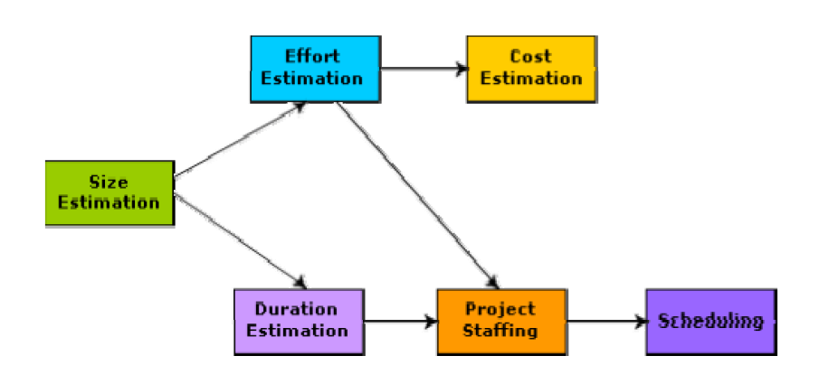
Precedence ordering among project planning activities

Slide 9
Problem in Project Planning
Commitment to unrealistic time and resource estimates result in schedule slippage.
Schedule delays can cause customer dissatisfaction and adversely affect team morale.
However, project planning is a very challenging activity. Especially for large projects, it is very much difficult to make accurate plans.
A part of this difficulty is due to the fact that the proper parameters, scope of the project, project staff, etc. may change during the span of the project.

Slide 10
Solution: Sliding Window Planning
Planning a project over a number of stages protects managers from making big commitments too early.
This technique of staggered planning is known as Sliding Window Planning.
Starting with an initial plan, the project is planned more accurately in successive development stages.
After the completion of every phase, the project managers can plan each subsequent phase more accurately and with increasing levels of confidence.

Slide 11
Software Project Management Plan (SPMP)
1. Introduction
(a) Objectives
(b) Major Functions
(c) Performance Issues
(d) Management and Technical Constraints
2. Project Estimates
(a) Historical Data Used
(b) Estimation Techniques Used
(c) Effort, Resource, Cost, and Project Duration Estimates
3. Schedule
(a) Work Breakdown Structure
(b) Task Network Representation
(c) Gantt Chart Representation
(d) PERT Chart Representation

Slide 12
Software Project Management Plan (SPMP)
4. Project Resources
(a) People
(b) Hardware and Software
(c) Special Resources
5. Staff Organization
(a) Team Structure
(b) Management Reporting
6. Risk Management Plan
(a) Risk Analysis
(b) Risk Identification
(c) Risk Estimation
(d) Risk Abatement Procedures
7. Project Tracking and Control Plan
8. Miscellaneous Plans
(a) Process Tailoring
(b) Quality Assurance Plan
(c) Configuration Management Plan

Slide 13
Project Estimation techniques
Empirical estimation techniques
Heuristic techniques
Analytical estimation techniques

Slide 14
Empirical Estimation Techniques
Based on making an educated guess of the project parameters.
Prior experience with development of similar products is helpful.
Although empirical estimation techniques are based on common sense, different activities involved in estimation have been formalized over the years.
Two popular empirical estimation techniques are: 1) Expert judgement technique
2) Delphi cost estimation

Slide 15
Expert Judgement Technique
An expert makes an educated guess of the problem size after analyzing the problem thoroughly.
Estimates the cost of the different components (i.e. modules or subsystems) of the system and then combines them to arrive at the overall estimate.
However, this technique is subject to human errors and individual bias.
A more refined form of expert judgement is the estimation made by group of experts.

Slide 16
Delphi cost estimation
It overcomes some of the shortcomings of the expert judgment approach.
Delphi estimation is carried out by a team comprising of a group of experts and a coordinator.
No discussion among the estimators is allowed during the entire estimation process.

Slide 17
Delphi cost estimation
The coordinator provides each estimator with a copy of the SRS document and a form for recording his cost estimate.
Estimators complete their individual estimates anonymously and submit to the coordinator.
The coordinator prepares and distributes the summary of the responses of all the estimators, and includes any unusual rationale noted by any of the estimators.
Based on this summary, the estimators re-estimate.
This process is iterated for several rounds.

Slide 18
After the completion of several iterations of estimations, the co-ordinator takes the responsibility of compiling the results and preparing the final estimate. The Delphi estimation, though consumes more time and effort, overcomes an important shortcoming of the expert judgement technique in that the results can not unjustly be influenced by overly assertive and senior members.

Slide 19
Software Size Metrics
LOC (Lines of Code):
Simplest and most widely used metric.
Comments and blank lines should not be counted.

Slide 20
Disadvantages of Using LOC
Size can vary with coding style.
Focuses on coding activity alone.
Correlates poorly with quality and efficiency of code.
Penalizes higher level programming languages, code reuse, etc.

Slide 21
Disadvantages of Using LOC (cont...)
Measures lexical/textual complexity only.
does not address the issues of structural or logical complexity.
Difficult to estimate LOC from problem description.
So not useful for project planning

Slide 22
Function Point Metric
Overcomes some of the shortcomings of the LOC metric
Proposed by Albrecht and Gaffney in 1983
The function point metric is based on the idea that a software product supporting many features would certainly be of larger size than a product with less number of features.

Slide 23
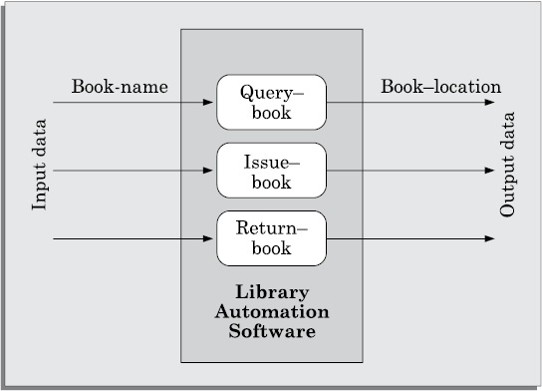
Function Point Metric

Slide 24
Question
Which factor we have to evaluate first to estimate efforts of the software project?
Cost Estimation
Duration Estimation
Size Estimation
Staffing Estimation

Slide 25
Heuristic Techniques
It assumes that the relationships among the different project parameters can be modelled using suitable mathematical expressions.
Once the basic (independent) parameters are known, the other (dependent) parameters can be easily determined by substituting the value of the basic parameters in the mathematical expression.
Two classes:
1) single variable model and
2) multi variable model

Slide 26

Single variable estimation models
It provides a means to estimate the desired characteristics of a problem, using some previously estimated basic (independent) characteristic of the software product such as its size.
Estimated Parameter =
e is the characteristic of the software which has already been estimated (independent variable)
c1 and d1 are constants determined using data collected from past projects (historical data).

Slide 27
Multivariable cost estimation model
Where e1, e2, … are the basic (independent) characteristics of the software already estimated, and c1, c2, d1, d2, … are constants.
Multivariable estimation models are expected to give more accurate estimates.

Slide 28
COCOMO Model
COCOMO (COnstructive COst MOdel) proposed by Boehm[1981]
Divides software product developments into 3 categories:
Organic
Semidetached
Embedded

Slide 29
Elaboration of Product classes
Organic:
Relatively small groups
working to develop well-understood applications.
Semidetached:
Project team consists of a mixture of experienced and inexperienced staff.
Embedded:
The software is strongly coupled to complex hardware, or stringent regulations on operational procedures exist.

Slide 30
COCOMO Model (CONT.)
For each of the three product categories:
From size estimation (in KLOC), Boehm provides equations to predict:
project duration in months
effort in person-months
Boehm obtained these equations:
examined historical data collected from a large number of actual projects.

Slide 31
COCOMO Model (CONT.)
Software cost estimation is done through three stages:
Basic COCOMO,
Intermediate COCOMO,
Complete COCOMO.

Slide 32
Basic COCOMO Model (CONT.)
Gives only an approximate estimation:
Effort = a1*(KLOC)^{a2}
Tdev = b1*(Effort)^{b2}
KLOC is the estimated kilo lines of source code,
a1,a2,b1,b2 are constants for different categories of software products,
Tdev is the estimated time to develop the software in months,
Effort estimation is obtained in terms of person months (PMs).

Slide 33
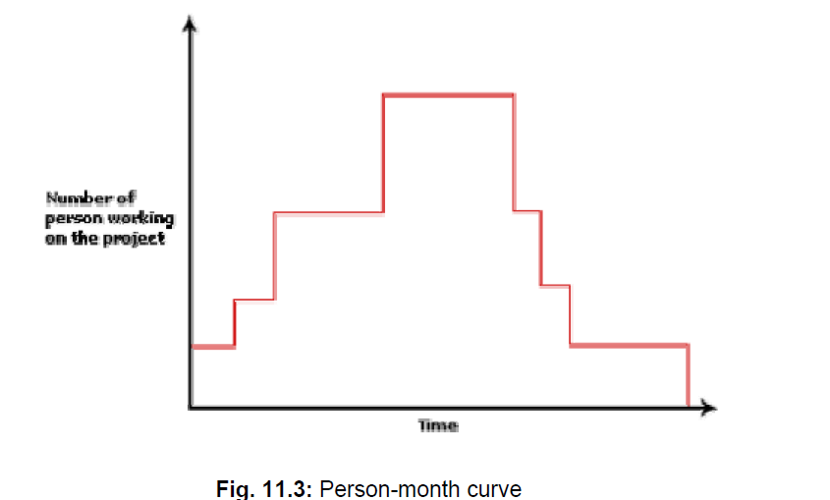

Slide 34
Development Effort Estimation
Organic :
Effort = 2.4 (KLOC)^{1.05} PM
Semi-detached:
Effort = 3.0(KLOC)^{1.12} PM
Embedded:
Effort = 3.6 (KLOC)^{1.20} PM

Slide 35
Development Time Estimation
Organic:
Tdev = 2.5 (Effort)^{0.38} Months
Semi-detached:
Tdev = 2.5 (Effort)^{0.35} Months
Embedded:
Tdev = 2.5 (Effort)^{0.32} Months

Slide 36
Basic COCOMO Model (CONT.)
Effort is somewhat super-linear in problem size.
Semidetached
Effort
Embedded
Organic
Size

Slide 37
Basic COCOMO Model (CONT.)
Development time
sublinear function of product size.
When product size increases two times,
development time does not double.
Dev. Time
Embedded
Semidetached
18 Months
14 Months
Organic
30K
60K
Size

Slide 38
Basic COCOMO Model (CONT.)
Development time does not increase linearly with product size:
For larger products more parallel activities can be identified:
can be carried out simultaneously by a number of engineers.

Slide 39
Basic COCOMO Model (CONT.)
Development time is roughly the same for all the three categories of products:
For example, a 60 KLOC program can be developed in approximately 18 months
regardless of whether it is of organic, semi-detached, or embedded type.
There is more scope for parallel activities for system and application programs,
than utility programs.

Slide 40
Cost Estimation
From the effort estimation, project cost can be obtained by multiplying the estimated effort (in man-month) by the manpower cost per month

Slide 41
Example
Assume that the size of an organic type software product has been estimated to be 32,000 lines of source code. Assume that the average salary of a software developer is Rs. 15,000 per month. Determine the effort required to develop the software product, the nominal development time, and the cost to develop the product.

Slide 42
Example
From the basic COCOMO estimation formula for organic software: Effort = 2.4*(32)^{1.05} = 91 PM
Development time = 2.5*(91)^{0.38} = 14 months
Total cost required to develop the product = 91 × Rs. 15, 000 = Rs. 1,365,000

Slide 43
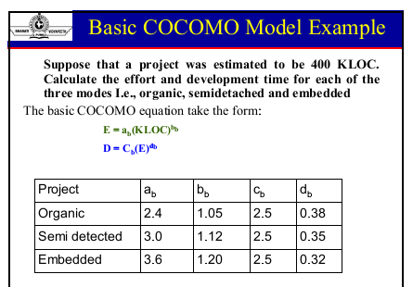

Slide 44
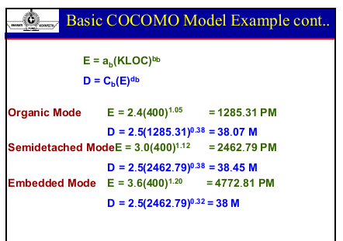

Slide 45
Suppose you are developing a software of organic type. You have estimated the size of the product to be around 100,000 Lines of Code. Compute the effort and the development type.

Slide 46
Intermediate COCOMO model
The basic COCOMO model assumes that effort and development time are functions of the product size alone.
However, a host of other project parameters besides the product size affect the effort required to develop the product as well as the development time.
Therefore, in order to obtain an accurate estimation of the effort and project duration, the effect of all relevant parameters must be taken into account.

Slide 47
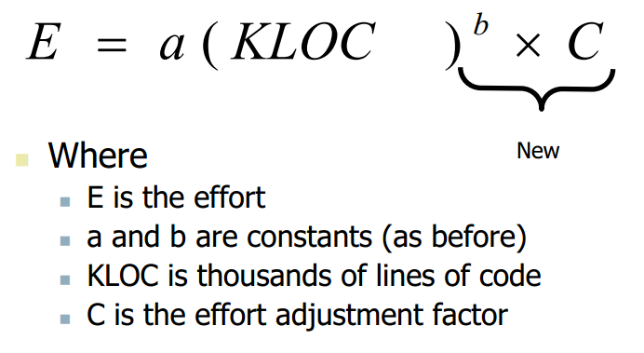

Slide 48
Development Effort Estimation
Organic :
Effort = 3.2 (KLOC)^{1.05} PM
Semi-detached:
Effort = 3.0(KLOC)^{1.12} PM
Embedded:
Effort = 2.8 (KLOC)^{1.20} PM

Slide 49
15 Cost Drivers
Boehm requires the project manager to rate these 15 different parameters for a particular project
Then, depending on these ratings, he suggests appropriate cost driver values which should be multiplied with the initial estimate obtained using the basic COCOMO.

Slide 50
Classification of Cost Drivers
Product: The characteristics of the product that are considered include the inherent complexity of the product, reliability requirements of the product, etc.
Computer: Characteristics of the computer that are considered include the execution speed required, storage space required etc.
Personnel: The attributes of development personnel that are considered include the experience level of personnel, programming capability, analysis capability, etc.
Development Environment: Development environment attributes capture the development facilities available to the developers. An important parameter that is considered is the sophistication of the automation (CASE) tools used for software development.

Slide 51
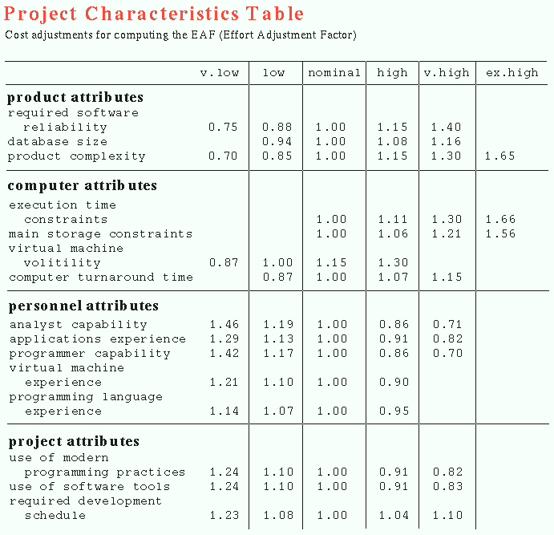

Slide 52
Shortcoming of basic and intermediate COCOMO models
Both models:
consider a software product as a single homogeneous entity:
However, most large systems are made up of several smaller sub-systems.
Some sub-systems may be considered as organic type, some may be considered embedded, etc.
for some the reliability requirements may be high, and so on.

Slide 53
Complete COCOMO
Cost of each sub-system is estimated separately.
Costs of the sub-systems are added to obtain total cost.
Reduces the margin of error in the final estimate.

Slide 54
Complete COCOMO Example
A Management Information System (MIS) for an organization having offices at several places across the country:
Database part (semi-detached)
Graphical User Interface (GUI) part (organic)
Communication part (embedded)
Costs of the components are estimated separately:
summed up to give the overall cost of the system.

Slide 55
Question
The size of software product has been estimated to be 82,000 lines of source code and effort adjustment factor is 2.41
Calculate Efforts?

Slide 56
Project scheduling
It involves deciding which tasks would be taken up when. Activities undertaken:
1. Identify all the activities needed to complete the project.
2. Break down large activities into tasks.
3. Determine the dependency among different tasks.
4. Establish the most likely estimates for the time durations necessary to complete the activities.
5. Represent the information in the form of activity network
6. Plan the starting and ending dates for various activities.
7. Determine the critical path. A critical path is the chain of tasks that determines the duration of the project.
8. Allocate resources to tasks.

Slide 57
Work breakdown structure
Work Breakdown Structure (WBS) is used to recursively decompose a given set of activities into smaller activities.
The root of the tree is labelled by the problem name.
Each node of the tree is broken down into smaller activities that are made the children of the node.
Each activity is recursively decomposed into smaller sub-activities until at the leaf level, the activities requires approximately two weeks to develop.

Slide 58
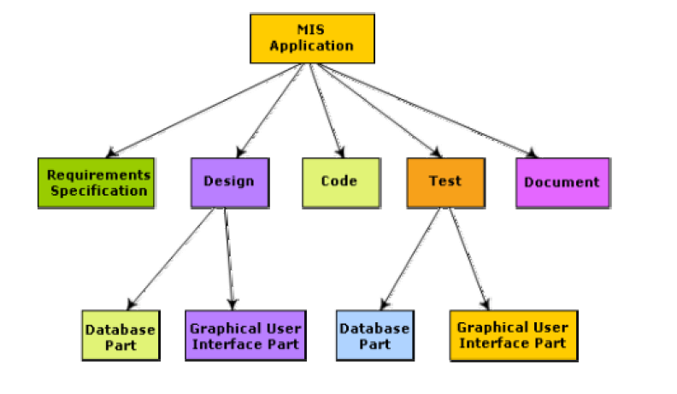
Work breakdown structure of MIS problem

Slide 59
Activity networks and critical path method
WBS representation of a project is transformed into an activity network by representing activities identified in WBS along with their interdependencies.
An activity network shows the different activities making up a project, their estimated durations, and interdependencies.

Slide 60
Activity network representation of the MIS problem
Activity | Predecessor Activity | Duration (Days)
Specification | - | 15
Design Database | Specification | 45
Design GUI Part | Specification | 30
Write User Manual | Specification | 60
Code Database | Design Database | 105
Code GUI Part | Design GUI Part | 45
Integration Test | Code Database, Code GUI Part | 120
Finish | Integration Test, Write User Manual | 0

Slide 61
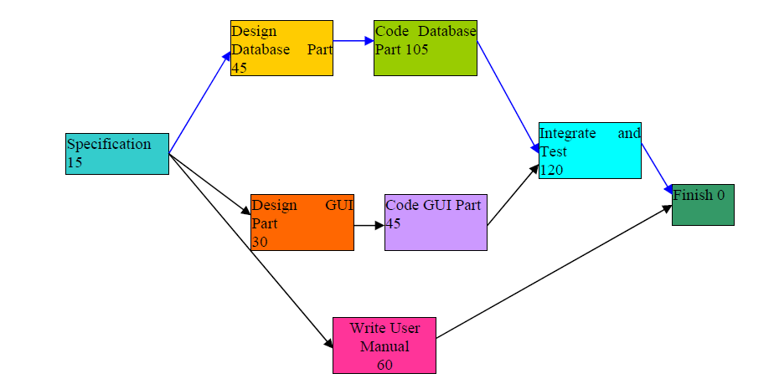
Activity network representation of the MIS problem

Slide 62
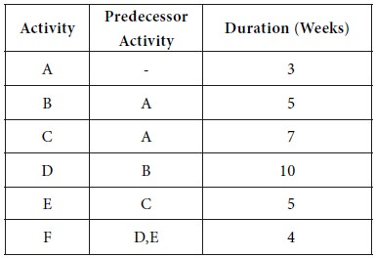
Example

Slide 63
Critical Path Method (CPM)
The minimum time (MT) to complete the project is the maximum of all paths from start to finish.
The earliest start (ES) time of a task is the maximum of all paths from the start to the task. This is simply the earliest time that a task can be started in your project. You cannot determine this without first knowing if there are any task dependencies
The latest start time is the difference between MT and the maximum of all paths from this task to the finish. This is the very last minute in which you can start a task before it threatens to delay your project schedule
The earliest finish time (EF) of a task is the sum of the earliest start time of the task and the duration of the task.The earliest an activity can be completed, based on its duration and its earliest start time
The latest finish (LF) time of a task can be obtained by subtracting maximum of all paths from this task to finish from MT. The latest an activity can be completed, based on its duration and its latest start time
The slack time (ST) is LS – EF and equivalently can be written as LF – EF.

Slide 64
Slack Time
The slack time (or float time) is the total time that a task may be delayed before it will affect the end time of the project.
The slack time indicates the “flexibility” in starting and completion of tasks.
A critical task is one with a zero slack time. A path from the start node to the finish node containing only critical tasks is called a critical path.

Slide 65
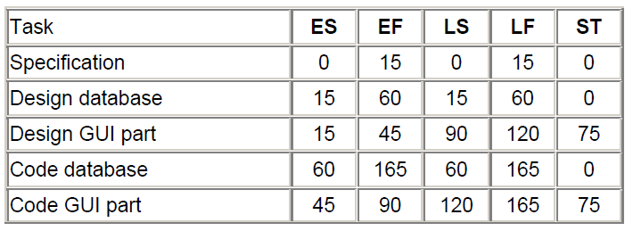

Parameters for different tasks of MIS Problem

Slide 66
Question
What is slack time?
a: Total time that a task may be delayed before it will affect the end time of the project.
B: The maximum of all paths from start to finish
C: The difference between MT and the maximum of all paths from this task to the finish
D: The sum of the earliest start time of the task and the duration of the task

Slide 67
CPM graph Example
Activity | Predecessor | Duration (in months)
A | - | 5
B | A | 4
C | A | 5
D | B | 6
E | C | 3
F | D,E | 4

Slide 68
CPM graph
B
D
Start
F
Finish
A
C
E

Slide 69
Critical Path Calculation
ES | MT (D) | EF
 | Activity
LS | SL | LF
ES : Earliest start time
MT(D): Maximum Time/Duration
EF : Earliest Finish Time
LS: Latest Start Time
SL: Slack Time
LF: Latest Finish Time
Activity : Critical activity of the project.
Formulae:
EF = ES + D
SL = LF – EF
LS = LF – MT (D)
ES = Predecessor’s EF
LF = successor’s LS

Slide 70
0 | 5 | 5
 | A
5 | 4 | 9
 | B
5 | 5 | 10
 | C
9 | 6 | 15
 | D
10 | 3 | 13
 | E
15 | 4 | 19
 | F

Slide 71
SL = LF – EF
LS = LF – D
Start calculation from the finish (last) activity = F
15 | 4 | 19
 | F
15 | 0 | 19
10 | 3 | 13
 | E
12 | 2 | 15
9 | 6 | 15
 | D
9 | 0 | 15
5 | 5 | 10
 | C
7 | 2 | 12
5 | 4 | 9
 | B
5 | 0 | 9
0 | 5 | 5
 | A
0 | 0 | 5
71

Slide 72
Critical Paths
From the given example, we have 2 paths:
A->B->D->F
A->C->E->F
B
D
Start
F
Finish
A
C
E
72

Slide 73
Critical Paths contd
However, a critical path is the one which has 0 Slack Time (SL)
Therefore, out of the two paths,
A->B->D->F path has 0 slack time.
0 | 5 | 5
 | A
0 | 0 | 5
5 | 4 | 9
 | B
5 | 0 | 9
9 | 6 | 15
 | D
9 | 0 | 15
15 | 4 | 19
 | F
15 | 0 | 19

Slide 74
CPM Table:
Activity | ES | MT (D) | EF | LS | SL | LF
A | 0 | 5 | 5 | 0 | 0 | 5
B | 5 | 4 | 9 | 5 | 0 | 9
C | 5 | 5 | 10 | 7 | 2 | 12
D | 9 | 6 | 15 | 9 | 0 | 15
E | 10 | 3 | 13 | 12 | 2 | 15
F | 15 | 4 | 19 | 15 | 0 | 19

Slide 75
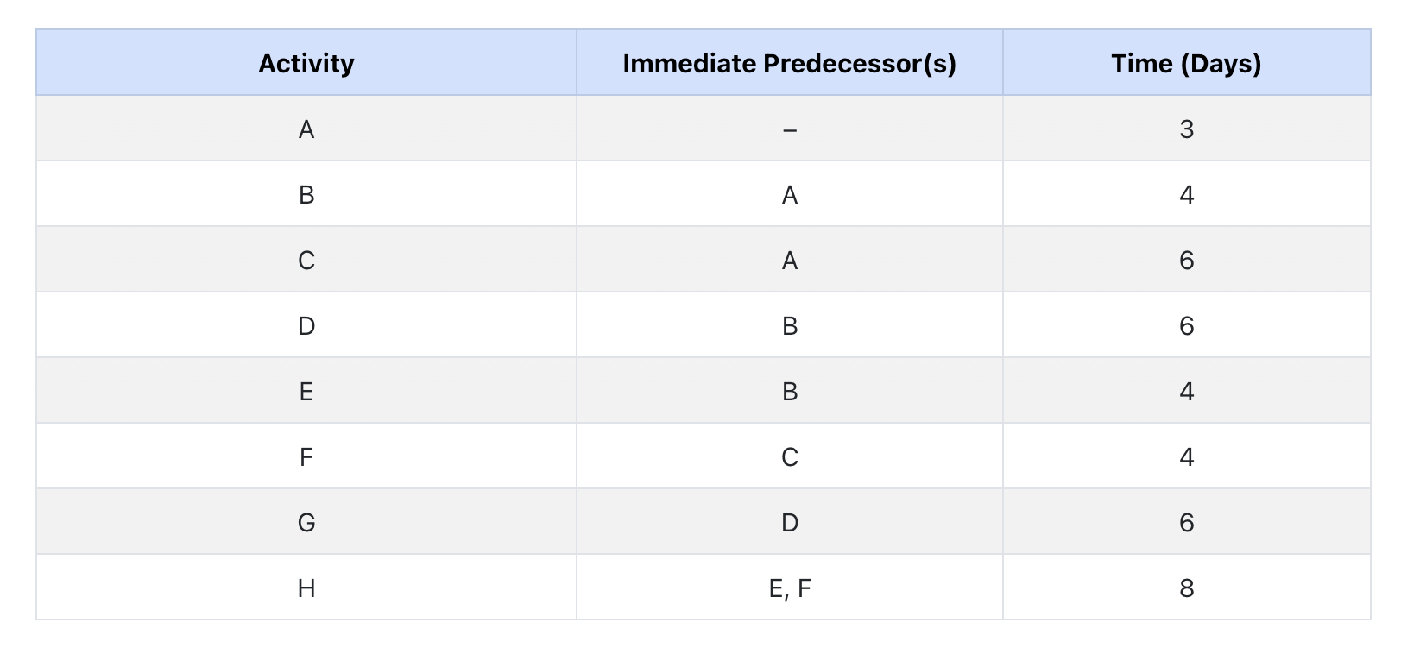

Slide 76
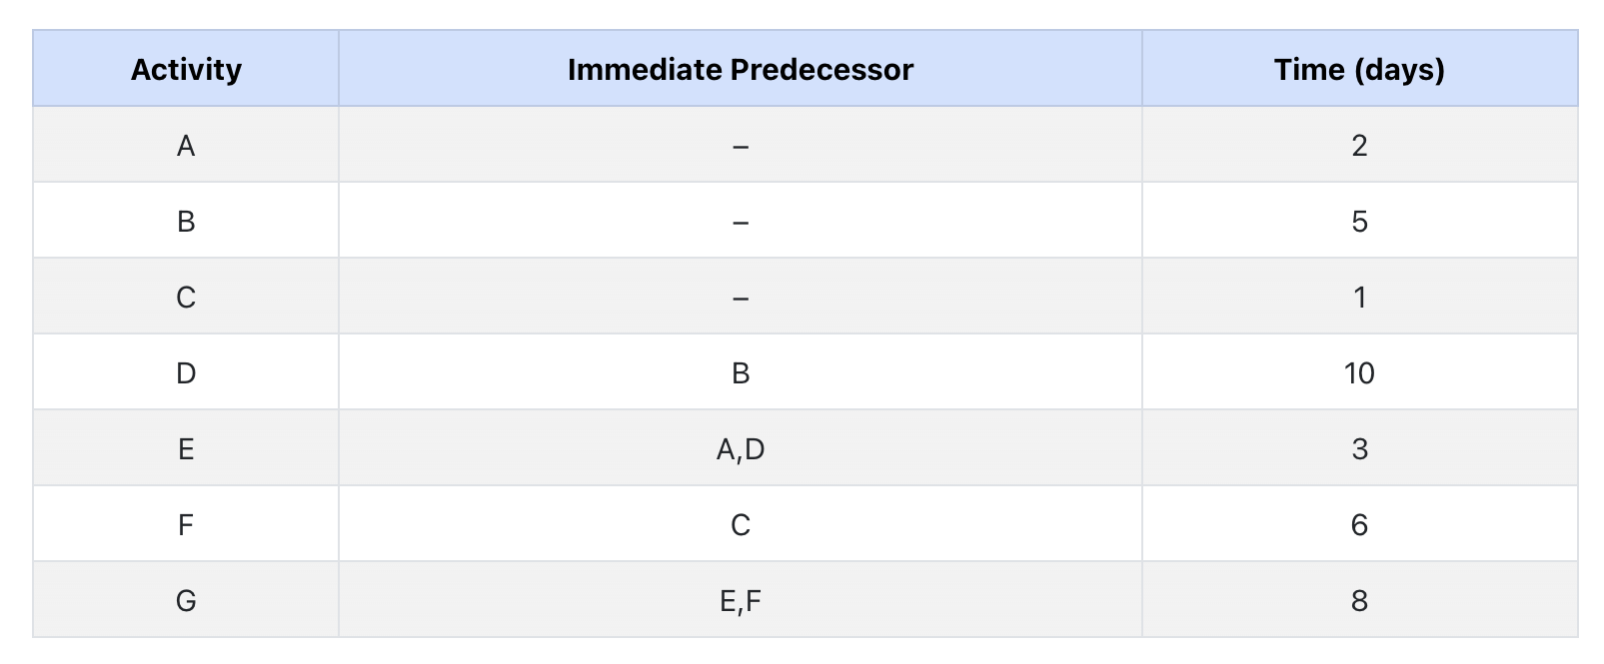

Slide 77
Critical Path
Task dependencies define a partial ordering among tasks, i.e.
Completion of some tasks must precede the starting time of some other tasks.
A critical path:
along which every milestone is critical to meeting the project deadline.
A Critical Path is a chain of tasks that determine the duration of the project.

Slide 78
Critical Paths
A critical paths is sequence of tasks such that
a delay in any of the tasks will cause a delay to the entire project.
There can be more than one critical path in a project.
It is important for the project manager to be aware of the critical paths in a project:
can ensure that tasks on these paths are completed on time.

Slide 79
Critical Paths
Other tasks may have some room for delay without affecting the entire project.
If necessary, the manager may switch resources from a noncritical task to a critical task.
Several software packages are available for automating the scheduling process:
MacProject on Apple Macintosh computer
MS-Project on Microsoft Windows Operating System.

Slide 80
CPM and PERT Charts
While Gantt charts show the different tasks and their durations clearly:
they do not show intertask dependencies explicitly.
this shortcoming of Gantt charts is overcome by PERT charts.

Slide 81
Critical Path Management
Critical Path Management(CPM) is a technique for:
Identifying critical paths
Managing project.
The CPM technique is not specific to software engineering
has a much wider use.

Slide 82
Critical Path Management
CPM can assist in answering questions like:
What are the critical paths in the project?
What is the shortest time in which the project can be completed?
What is the earliest (or latest) time a task can be started (or finished) without delaying the project?

Slide 83
Example
A project involves three tasks:
task a takes 4 hours,
task b takes 5 hours
task c takes 8 hours.
task c cannot commence until task a is completed.
What is the shortest time in which the project can be completed?
b
5
finish
start
4
a
c
8

Slide 84
Example
Clearly, the project continues until task a and then task c complete:
which is 12 hours.
Task b takes only 5 hours.
Task b can have 7 hours of leeway to start and finish.
b
5
finish
start
4
a
c
8

Slide 85
What data do we need to construct a CPM graph?
To construct a CPM graph,
a list of tasks and their durations are required.
Also, for each task a list of tasks upon which it depends is required.
A task may depend on more than one task.
Project task details can be given in the form of a table.

Slide 86
Task Table
Task Duration Dependents

Slide 87
CPM Graph
c:20
a:10
start
finish
g:5
b:20
f:5
d:10
e:10

Slide 88
How do we work out the various start and finish times for tasks?
Minimum time to complete project (MT) = Maximum of all paths from start to finish
Earliest start time (ES) of a task = Maximum of all paths from start to this task
Earliest finish time (EF) of a task = ES + duration of the task
Latest finish time (LF) of a task = MT - Maximum of all paths from this task to finish
Slack time = LS - ES = LF - EF

Slide 89
Start and finish times for tasks.
Latest start time (LS) of a task = LF - duration of the task Task MT EF ES LF LS

Slide 90
What are the float time (or slack time) of tasks?
Float time (or slack time) is the total time that a task may be delayed
before it will affect the end time of the project.
The float times indicate the "flexibility" in starting and completion of tasks:
A critical activity is an activity with zero (0) slack or float time.

Slide 91
What is PERT and how does it work?
PERT (Program Evaluation and Review Technique) is a variation of CPM:
incorporates uncertainty about duration of tasks.
Gantt charts can be derived automatically from PERT charts.
Gantt chart representation of schedule is helpful in planning the utilization of resources,
while PERT chart is more useful for monitoring the timely progress of activities.

Slide 92
RISK MANAGEMENT

Slide 93
Risk Management
A risk is any unfavourable event or circumstance:
which might hamper successful or timely completion of a project.
Risk management:
concerned with the reduction of the impact of risks.
Risk management consists of three activities:
risk identification,
risk assessment, and
risk containment.

Slide 94
Risk identification
To be able to identify various risks:
we must categorize risks into different classes.
Three main categories of risks can affect a software project:
project risks
technical risks
business risks

Slide 95
Project Risks
Project risks associated with:
budget,
schedule,
personnel,
resource

Slide 96
Technical Risks
Technical risks concern:
requirements specification
(e.g ambiguous, incomplete, changing specifications)
design problems,
implementation problems,
interfacing problems,
testing, and maintenance problems.

Slide 97
Business Risks
Business Risks include:
building an excellent product that no one wants,
It is a good idea to have a “company disaster list”,
a list of all bad things that have happened in the past
project managers can jog their mind to see which items their project is vulnerable to.

Slide 98
Examples
What if the project cost escalates and overshoots what was estimated?
What if the mobile phones that are developed become too bulky in size to conveniently carry?
What if call hand-off between satellites becomes too difficult to implement?

Slide 99
Risk assessment
Objective of risk assessment is to prioritize the risks:
Likelihood of a risk being real.
Consequence of the problems associated with that risk.
Prioritization helps in handling the most damaging risks first.
Priority of a risk is the product of the likelihood of the risk and the consequences of the problems associated with that risk.

Slide 100
Risk assessment
The objective of risk assessment is to rank the risks in terms of their damage causing potential.
For risk assessment, first each risk should be rated in two ways:
The likelihood of a risk becoming real (r).
The consequence of the problems associated with that risk (s).
Based on these two factors, the priority of each risk can be computed as follows:
p = r * s

Slide 101
Risk Handling
Three main strategies for risk handling:
Avoid the risk: e.g. change the requirements for performance or functionality.
Transfer the risk: allocate risks to third party
or buy insurance to cover any financial loss should the risk become a reality.
Contingency planning: Prepare contingency pans to minimize the impact of the risk.

Slide 102
Risk Handling
To decide about risk handling options, we must take into account:
cost of reducing risk
resulting cost saving from risk reduction.

Slide 103
Risk Containment
Let us see how we can contain an important type of risk:
schedule slippage
can be dealt with by increasing the visibility of the project.
Milestones are placed at regular intervals
provide a manager with regular indication of progress.

Slide 104
Containing Schedule Slippage
A milestone is reached,
when documentation produced has successfully been reviewed.

Slide 105
Software Configuration Management
The results (aka deliverables) of any large software development effort consists of a large number of objects:
source code,
design document,
SRS document,
test document,
project plan (SPMP) document, etc.

Slide 106
Software Configuration Management (CONT.)
A configuration is a collection of deliverables:
being developed for some customer.
As development proceeds,
the components comprising a configuration undergo changes:
Even during maintenance, the components comprising a configuration keep changing.

Slide 107
What is configuration management?
The set of activities through which the configuration items are managed and maintained
as the product undergoes its life cycle phases.

Slide 108
Versions
A configuration for a particular system is called a version:
The initial delivery might consist of several versions,
more versions might be added later on.
For example, one version of a mathematical package might run on a Unix machine,
another on Windows NT, and
another on Solaris.

Slide 109
Versions
As a software is released and used by the customers:
errors are discovered,
enhancements to the functionalities might be needed.
A new release of the software is an improved system intended to replace an old one.
Usually a product is described as version m and release n (or as version m.n)

Slide 110
Software Configuration Management
Existence of variants of a software product causes several problems.
Suppose you have several versions of the same module, and
find a bug in one of them.
it has to be fixed in all versions.

Slide 111
Software Configuration Management
Different objects are accessed and modified by a number of engineers.
Unless strict discipline is enforced:
regarding updation and storage of the objects through some automated tool,
several problems appear.

Slide 112
Software Configuration Management
For example, an engineer might update the module that he has designed ---
without informing the engineers who need to interface with this module.
Or, two engineers may simultaneously carry out changes to different portions of a module:
while saving overwrite each other.

Slide 113
Why Configuration Management?
To be able to identify the exact state of different deliverables at any time.
To avoid the problems associated with having replicated objects accessible by multiple engineers.
Controlling concurrent work on a module by different engineers. (Overwriting one engineer’s work by another)
Letting different engineers work on related modules at the same time.
Keeping track of variants (versions) and helping fix bugs in them.
Storing versions and revisions efficiently.
Maintaining revision history (accounting).

Slide 114
Software Configuration Management
Configuration management helps to:
quickly determine the current state of the product
change the various components (modifications, revisions, variations etc.) in a controlled manner.
maintaining the current up-to-date status of various versions of the software,
control and account changes to the product.

Slide 115
In short
Inconsistency problem when the objects are replicated-changes to local copy bt not informing
Problems associated with concurrent access
Providing a stable development environment-A integrates , B and C changes –cont,etc
System accounting and maintaining status information
Handling variants

Slide 116
Baseline
A baseline is the status of all the objects under configuration control. When any of the objects under c control is changed, a new baseline gets formed.
It may be archived periodically(copying to a safe place) so that the last baseline can be recovered in case of disaster.

Slide 117
Software Configuration Management Activities
Configuration management is carried out through three principal activities:
configuration identification,
configuration control,
configuration accounting and reporting.

Slide 118
Software Configuration Management Activities
Configuration identification
which parts of the system must be kept track of?
Configuration control
ensures that changes to a component happen smoothly.
Configuration accounting
keeps track of what has been changed, when, and why.

Slide 119
Configuration Identification
Deliverable objects can be classified into three main categories:
controlled,
precontrolled,
uncontrolled.
Controlled objects are under configuration control:
you must follow some formal procedures to change them.

Slide 120
Configuration Identification
Precontrolled objects are not yet under configuration control,
but may eventually be under configuration control.
Uncontrolled objects are not and will not be subject to configuration control.

Slide 121
Configuration Identification
Typical controllable objects include:
Design documents
Tools used to build the system, such as compilers, linkers, lexical analyzers, parsers, etc.
Source code for each module
Test cases
Problem reports

Slide 122
Configuration Control
Configuration control is the process of managing changes.
It is the part of configuration management that most directly affects day-to-day operations of the developers.
Once an object goes under configuration control,
any further changes requires approval from a change control board (CCB).

Slide 123
Configuration Control
The CCB is constituted from among the development team members.
For every change carried out,
CCB certifies several things about the change:
Change is well-motivated.
Developer has considered and documented the effects of change.
Appropriate people have validated the change.

Slide 124
Configuration Control
An important reason for configuration control:
people need a stable environment to develop a software product.
Suppose you are trying to integrate module A, with the modules B and C,
you cannot make progress if developer of module C keeps changing it;
this is especially frustrating if a change to module C forces you to recompile A.
As soon as a document under configuration control is updated,
the updated version is frozen and is called a baseline.

Slide 125
Configuration Control
Baseline
New Baseline
A
B
A
B
C
D
C’
D
Reserve
Replace
Cancel Reservation
C
Private Copy

Slide 126
Configuration Control
This establishes a baseline for others to use.
Freezing a configuration may involve archiving everything needed to rebuild it.
Archiving means copying to a safe place such as a magnetic tape.
At any given time, a programmer may pay attention to:
Current baseline configuration
Programmer's private version

Slide 127
SCCS (Source Code Control System)
SCCS is a configuration management tool:
available on Unix systems:
helps control and manage text files.
also implements an efficient way of storing versions:
minimizes the amount of occupied disk space.

Slide 128
SCCS
Suppose a module is present in 3 versions:
MOD1.1, MOD1.2, and MOD1.3.
SCCS stores the original module MOD1.1
together with changes needed to transform it into MOD1.2 and MOD1.3.
the modifications are called deltas.

Slide 129
SCCS Features
Access control facilities provided by SCCS include:
facilities for checking components in and out.
Individual developers check out components and modify them.
after they have changed a module as required and the module has been successfully tested,
they check in the changed module into SCCS.

Slide 130
SCCS Features
Revisions are denoted by numbers in ascending order,
e.g, 1.1, 1.2, 1.3 etc.
It is also possible to create variants of a component
by creating a fork in the development history.

Slide 131
Summary
Project staffing requires careful understanding of the attributes of good software engineers.
Project scheduling:
break down large tasks into smaller logical units,
determine dependencies among tasks,
determine expected duration of tasks,
assign resources, and
assign times.

Slide 132
Summary
Several techniques are available to help in scheduling:
Work breakdown structure
Activity networks
Gantt charts
PERT and CPM
Commercial software tools are available to assist in developing these.

Slide 133
Summary
It is necessary to determine the critical paths in a project:
to meet the timing for critical activities.
An important project planning activity is risk management:
Risk identification
Risk assessment
Risk containment

Slide 134
Summary
Configuration management.
the set of activities by which a large number of objects are managed and maintained.

Slide 135
Gantt Chart
Gantt chart has been named after its developer Henry Gantt. A Gantt chart is a form of bar chart. The vertical axis lists all the tasks to be performed. The bars are drawn along the y-axis, one for each task

Slide 136
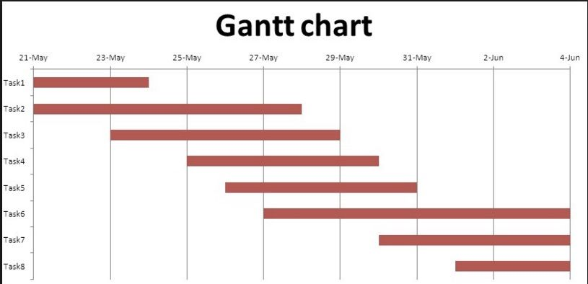
Example

Slide 137
PERT chart
PERT (Program Evaluation and Review Technique) charts consist of a network of boxes and arrows.
The boxes represent activities and the arrows represent task dependencies.
The boxes of PERT charts are usually annotated with the pessimistic, likely, and optimistic estimates for every task.

Slide 138
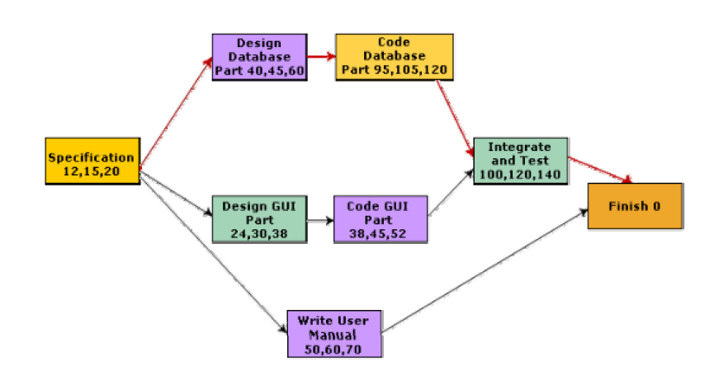
PERT chart representation of the MIS problem

Slide 139
Activity | Optimistic Time | Most Likely | Pessimistic
1-2 | 1 | 7 | 13
1-6 | 2 | 5 | 14
2-3 | 2 | 14 | 26
2-4 | 2 | 5 | 8
3-5 | 7 | 10 | 19
4-5 | 5 | 5 | 17
6-7 | 5 | 8 | 29
5-8 | 3 | 3 | 9
7-8 | 8 | 17 | 32

